Slide 1

Player creation, and basic movement
__________________________________________
2

Slide 2
2D Games and Dimensions
In 2D games, anything can move in only 2 directions: along the x-axis, along the y-axis, or along both. Values can be positive or negative
When a character jumps, the value of y changes
When a character walks/runs, the value of x changes
When two or more buttons are pressed, the values of x and y change together

Slide 3
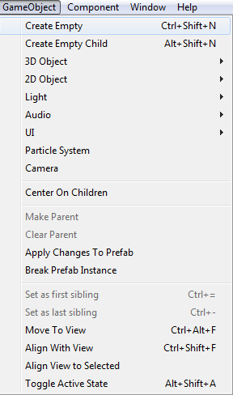
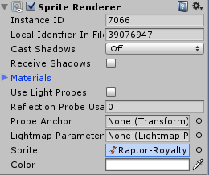
Exercise #9 - Create the Player GameObject
To create your player character:
Import a sprite of your character to the Project window in Unity
(you don’t need a complete sprite sheet this lab, as there will be no animation)
Go to the taskbar above, and choose GameObject. Create an empty
GameObject and name it Player GameObject in the Hierarchy window
A GameObject acts as a containers for Components, and these Components
(e.g. Rigidbody, Light, Sprite, etc.) are what implement the real functionalities
Select the GameObject, and from the Inspector window click
Add Component>Rendering>Sprite Renderer
Choose the sprite of your character and drag and drop it into the Sprite
property in the Sprite Renderer component in the Inspector pane

Slide 4
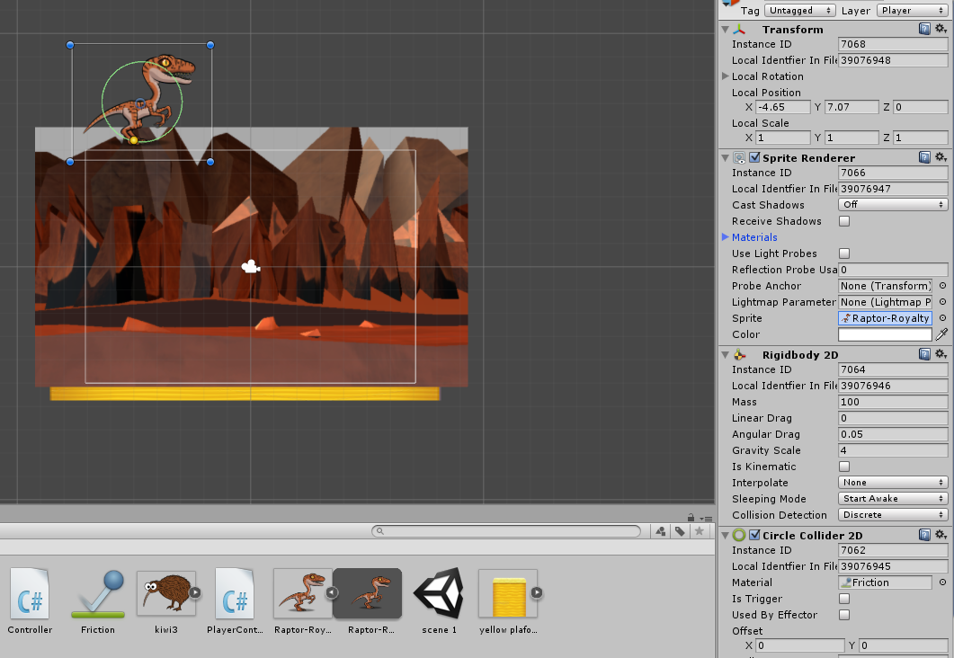

Slide 5
Exercise #9 - Create the Player (Cont.)
Create a RigidBody2D component (see Lab 1)
Set the Interpolate property to Interpolate
(Interpolation can be useful to control jerky movement. With interpolate mode, motion is smoothed based on the object's positions in previous frames)
Freeze rotation around axis Z
Create a BoxCollider2D (see Lab 1)
So that the player can interact with other objects, like the ground he stands on

Slide 6
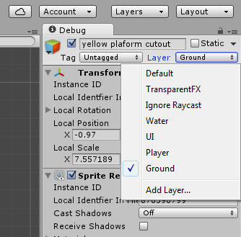
Exercise #9 - Create the Player (Cont.)
Adjust the Layers
Create a layer for solid ground that you want the
character to land on. Name it Ground
Create a layer for the character(s) that can interact with
the ground. Name it Player
After you’ve created those layers, select the Ground
layer for all grounds, and Player for your character

Slide 7
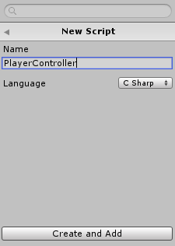
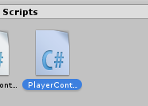
Exercise #10 - Adding a Script to Your Player
To write code for the player, we must add a script component.
Go to Add Component>New Script>C Sharp
Name the script PlayerController then Create
Drag the new script file to the Script property in Inspector window
Double-click the script file in Project window
Visual Studio should open by default
If it doesn’t, go to Edit>Preferences>External Tools>External Script Editor>
Click the dropdown list>Browse>Program Files(x86)>Microsoft Visual Studio>
2019>Common7>IDE>devenv

Slide 8
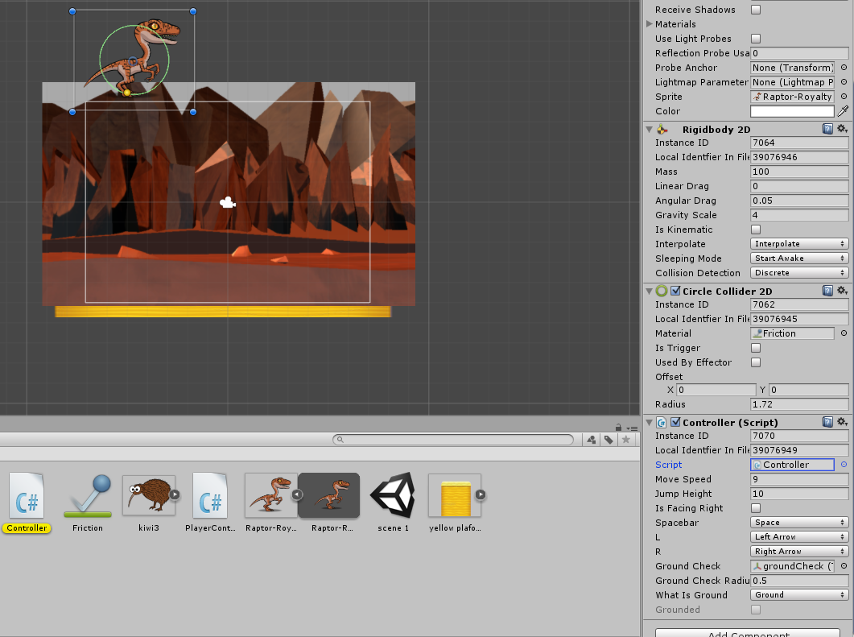

Slide 9
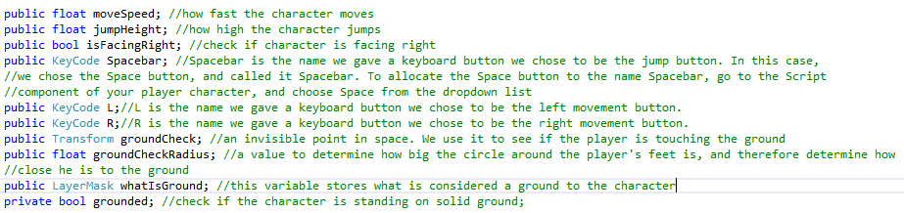
Exercise #10 - Adding a Script to Your Player (Cont.)
In Visual Studio, inside the default MonoBehaviour class, we will need to declare a few variables:

Slide 10
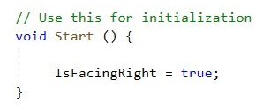
Exercise #10 - Adding a Script to Your Player (Cont.)
In the Start() function, create 3 variables and assign the scale (size) of the character’s sprite along the x,y and z axes:

Slide 11
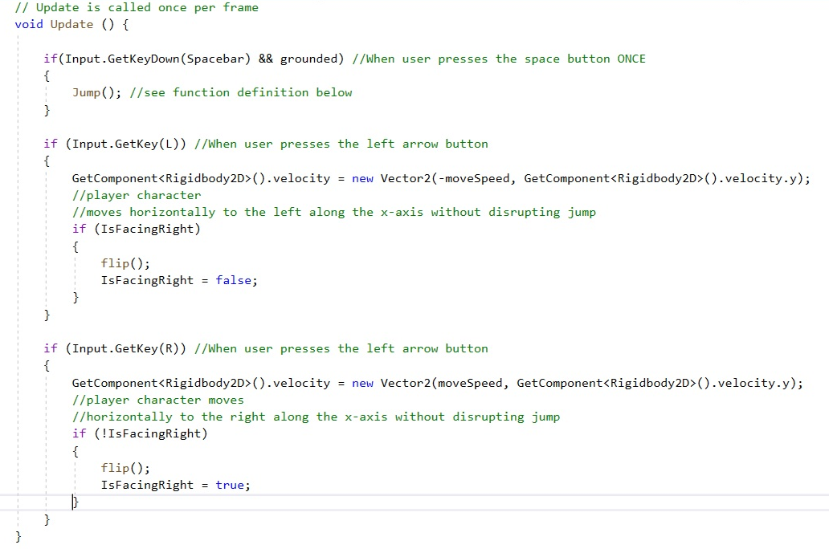
Exercise #10 - Adding a Script to Your Player (Cont.)
The Update() function is called once every single frame in your game. This is where things like character movement and animation are added, because they are things that happen every frame the game is in play mode.

Slide 12
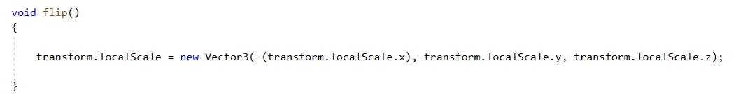
Exercise #10 - Adding a Script to Your Player (Cont.)
To make your character flip and face in the direction you want it to move, create an easy flip() function like this:
Now add it as a function call inside the Update() function

Slide 14
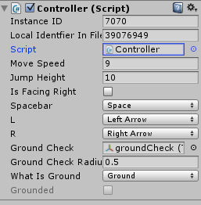
Exercise #10 - Adding a Script to Your Player (Cont.)
Save your work and return to Unity. You’ll find that the variables have been added as properties in the Script component in the Inspector window
Give the variables values. You can use the screenshot as example
For the What Is Ground property, select the Ground layer
You’ll notice a property called groundCheck. How do we create that?
groundCheck is very important – we need it to be able to tell the engine
when the character is standing on ground, and when they are in the air

Slide 15
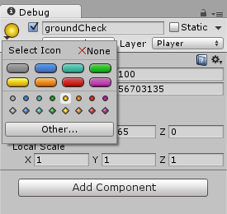
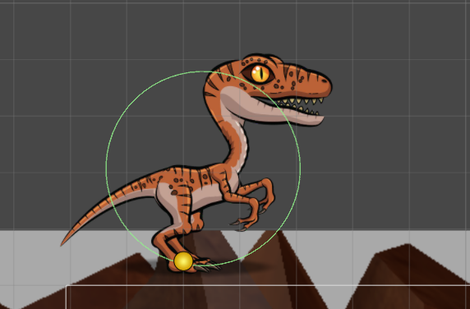
Exercise #10 - Adding a Script to Your Player (Cont.)
Create an Empty GameObject and name it groundCheck. Make it a child of Player GameObject by dragging it and dropping it on Player GameObject in the Hierarchy window
It is currently invisible on the Scene window. Give it a color by going to its Transform component in the Inspector window. Choose a circle and position it at the character’s feet

Slide 16
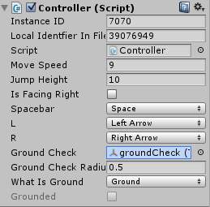
Exercise #10 - Adding a Script to Your Player (Cont.)
After you’ve created the groundCheck GameObject, drag it from the Hierarchy window onto the property textbox in the Inspector window

Slide 17
Exercise #10 - Adding a Script to Your Player (Cont.)
Go back to the code. We’ll begin with a simple Jump() function
GetComponent<Rigidbody2D> only works if your character responds to physics, so you MUST attach a Rigidbody2D component to it
This function makes your character jump by calculating its velocity using its walking speed (x-axis value) and the height to which it can jump (y-axis value)

Slide 18
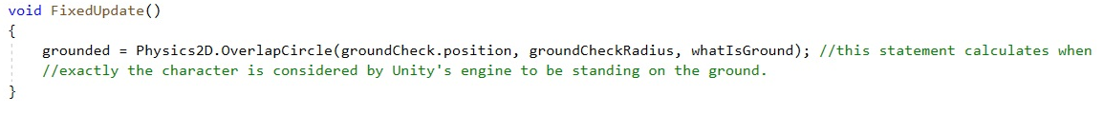
Exercise #10 - Adding a Script to Your Player (Cont.)
Create a FixedUpdate() function to calculate when the character is standing on ground
The groundCheck GameObject we have created is circular, and has a radius. This statement calculates if the circle overlaps with the ground’s boxcollider. If yes, the character is standing on the ground. If not, they are in the air.
Update() vs FixedUpdate():
While the Update() function is called every single frame, FixedUpdate() is called every 0.2 sec by default. You can change that value later if your game needs it
There isn’t any need to check for the Grounded value every single frame, which is why it was placed in FixedUpdate()

Slide 19
Exercise #10 - Adding a Script to Your Player (Cont.)
Now add Grounded as a condition to restrict the jump to only once per click:

Slide 20
Exercise #10 - Adding a Script to Your Player (Cont.)
How do we make the character flip horizontally when it changes direction?
Inside the update function, after calculating the character’s movement, we create an if-else statement to see whether the value of GetComponent<Rigidbody2D>().velocity.x is positive or negative
If positive, we use the equation transform.localScale = new Vector((value of x), (value of y), (value of z)) to make the character’s image flip to the right of the x-axis without any changes to its shape or size
If false, then transform.localScale = new Vector(-(value of x), (value of y), (value of z)) to make the image of the character flip to the left of the x-axis

Slide 21
Useful References
Johnson, M., Hasankolli, R., & Henley, J. A. (2014). Learning 2D Game Development with Unity: A Hands-on Guide to Game Creation. Pearson Education.
2D Character Controllers. URL retrieved from: https://unity3d.com/learn/tutorials/modules/beginner/2d/2d-controllers?playlist=17093
Unity’s New Input System in just 9 Minutes. URL retrieved from: https://www.youtube.com/watch?v=ptDoB00P8QY&list=PLJBcv4t1EiSxk9UuMkdk_14GBvEVQgsIW&index=3
How to make a 2D Platformer – Unity Tutorial by Brackeys. URL retrieved from: https://www.youtube.com/playlist?list=PLPV2KyIb3jR42oVBU6K2DIL6Y22Ry9J1c
Unity 2D Platformer Tutorial - Part 1 - Moving and Jumping. URL retrieved from: https://www.youtube.com/watch?v=86Bgt--Ww7w
The Difference Between Update() and FixedUpdate. URL retrieved from: https://unity3d.com/learn/tutorials/topics/scripting/update-and-fixedupdate

